Slide 1

DEPARTMENT OF CSE (ARTIFICIAL INTELLIGENCE AND MACHINE LEARNING) ACADEMIC YEAR 2025 - 2026 SEMESTER III ARTIFICIAL INTELLIGENCE LABORATORY MINI PROJECT REVIEW Randomized AI Decision Algorithm for Rock–Paper–Scissors
REGISTER NUMBER | 2117240030010
NAME | ARCHANA DV
YEAR | II
SECTION | A
FACULTY IN-CHARGE | Mrs. M. Divya

Slide 2
PROBLEM STATEMENT
Artificial Intelligence (AI) enables systems to exhibit intelligent behavior by analyzing patterns, making decisions, and adapting to various scenarios. This project focuses on developing a Randomized AI Decision Algorithm for Rock-Paper-Scissors using Python and Tkinter, where the AI uses a combination of randomness and simple strategic logic to compete against a human player. The system integrates probability-based decision-making and adaptive responses to ensure that the AI’s moves remain unpredictable while maintaining a fair challenge. Unlike purely rule-based or learning-based models, the AI here employs pseudo-random logic and pattern observation to simulate human-like spontaneity and strategic guessing. A Graphical User Interface (GUI) built with Tkinter enhances user interaction by providing real-time visual feedback for each round and displaying results dynamically. Overall, the system demonstrates how randomized algorithms and basic AI decision-making can be combined to create an interactive, engaging, and intelligent game-playing experience.

Slide 3
THEORETICAL BACKGROUND
Artificial Intelligence (AI) focuses on enabling machines to simulate human reasoning and decision-making. In traditional AI systems, logic-based reasoning and rule-based inference are used to make deterministic decisions. However, in dynamic and unpredictable environments like games, introducing randomization enhances realism and challenge.
The Rock-Paper-Scissors game provides an excellent framework to demonstrate AI decision-making through a randomized yet strategic approach. The AI algorithm in this project uses pseudo-random number generation combined with conditional logic to select moves, ensuring variability and fairness. This technique allows the system to mimic human unpredictability while maintaining logical consistency.

Slide 4
THEORETICAL BACKGROUND
Unlike machine learning models, which rely on data-driven learning, this project employs non-learning, probabilistic reasoning, where decisions are based on random selection and adaptive response. This makes the algorithm deterministic in structure but non-deterministic in behavior, providing both transparency and engagement.
A Tkinter-based Graphical User Interface (GUI) serves as the interaction medium between the user and the AI. It visually displays the moves, results, and scores, creating an interactive and enjoyable gameplay experience.
Overall, the theoretical foundation lies in combining AI decision logic, probability theory, and randomization techniques to create an intelligent, fair, and user-friendly Rock-Paper-Scissors game.

Slide 5
IMPLEMENTATION AND CODE
Link to code in Git-hub Repository
List | Git-hub Repository Links
Implementation of Code Link | https://github.com/Archana200612/ROCK-PAPER-

Slide 6
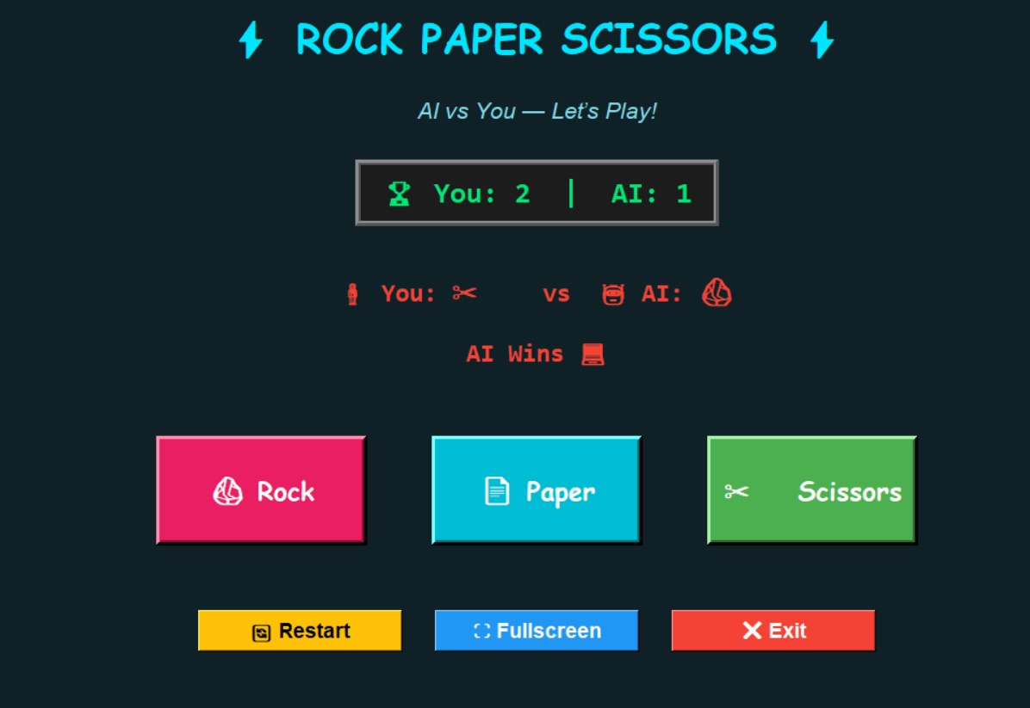
OUTPUT AND RESULTS
The output shows the Rock-Paper-Scissors game interface where the user plays against the AI. The scoreboard displays both scores, and the chosen moves are shown after each round. In this example, the user selected Scissors while the AI chose Rock, resulting in AI Wins. The buttons allow the user to select moves, restart the game, or exit. The GUI provides an interactive and user-friendly gaming experience.

Slide 7
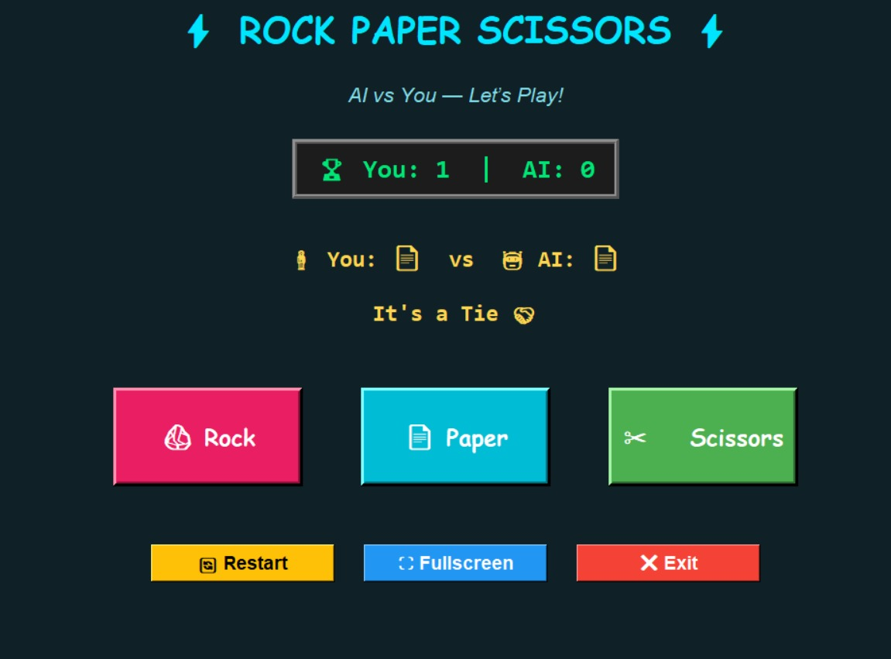
OUTPUT AND RESULTS
The output shows the Rock-Paper-Scissors game screen where both the user and the AI selected Paper. Since both choices are the same, the result is displayed as “It’s a Tie.” The scoreboard indicates the current scores — the user has 1 point, and the AI has 0 points. The colorful buttons (Rock, Paper, Scissors) allow the player to choose moves, while Restart, Fullscreen, and Exit provide easy game control through the Tkinter-based GUI.

Slide 8
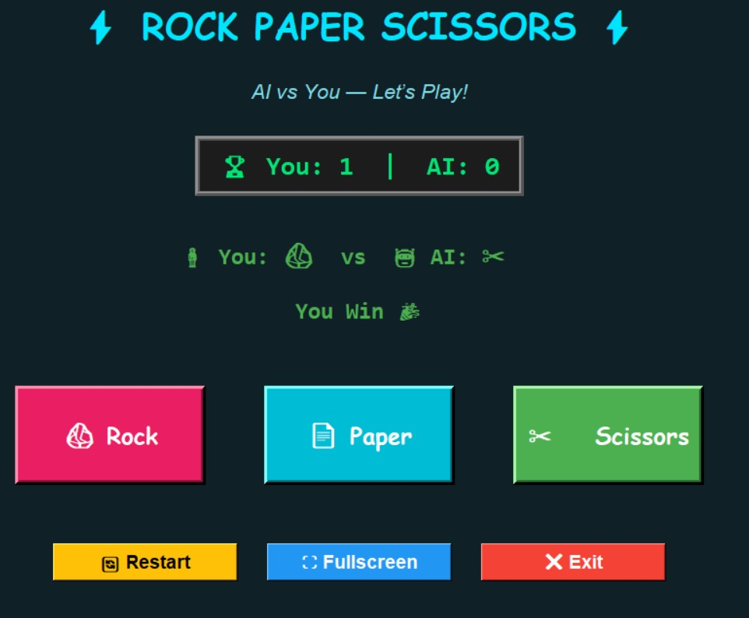
OUTPUT AND RESULTS
The output shows the Rock-Paper-Scissors game where the user chose Rock and the AI chose Scissors. According to the game rules, rock beats scissors, so the message “You Win” is displayed. The scoreboard shows the updated score — You: 1 | AI: 0. The interface includes colorful buttons (Rock, Paper, Scissors) for move selection and additional options like Restart, Fullscreen, and Exit for easy control, providing an interactive user experience.

Slide 9
OUTPUT AND RESULTS
Result
The output displays the working of the Randomized AI Decision Algorithm for Rock-Paper-Scissors game, where the AI competes with the user using logical and random decision-making. Each round shows results such as “You Win,” “AI Wins,” or “It’s a Tie” based on the moves chosen by both sides. The AI’s move is generated through a randomized algorithm, making every game unique and unpredictable. The system follows the standard Rock-Paper-Scissors rules to determine the winner after each selection. A Tkinter-based GUI provides a colorful and interactive interface for smooth gameplay. The scoreboard updates dynamically to reflect the ongoing match status. The restart and exit options allow players to easily manage new sessions. Overall, the result proves that the AI can make autonomous, fair, and intelligent decisions, creating an engaging gaming experience.

Slide 10
OUTPUT AND RESULTS
Multiplayer Mode: Add an option for two users to play against each other locally or online.
Smarter AI: Improve AI decision-making using predictive algorithms or reinforcement learning.
Difficulty Levels: Include Easy, Medium, and Hard levels to make the game more engaging.
Voice Commands: Enable players to make their moves using speech recognition.
Leaderboard System: Track and display high scores of players over multiple sessions.
Animated Interface: Add smooth transitions, emojis, and effects for better visual appeal.
Sound Effects: Introduce victory, tie, and move sounds for an immersive experience.
Statistics Feature: Show player performance graphs and win rates for analysis.

Slide 11
REFERENCES
References
Russell, S., & Norvig, P. (2020). Artificial Intelligence: A Modern Approach (4th Edition). Pearson Education.
GeeksforGeeks – Rock Paper Scissors AI using Python. Available at: https://www.geeksforgeeks.org/
W3Schools – Python Random Module Tutorial. Available at: https://www.w3schools.com/python/module_random.asp
Towards Data Science – Building Simple AI Games with Python. Available at: https://towardsdatascience.com/
Python Official Documentation – Tkinter GUI Programming. Available at: https://docs.python.org/3/library/tkinter.html

